Slide 1

2-DOF Tabletop Articulated Robotic Arm
Solid modeling & Multi-joint Trajectory Simulation
DEPARTMENT OF ELECTRICAL AND COMPUTER SYSTEMS ENGINEERING
UNIVERSITY OF DODOMA
COURSEWORK PHASE II

Slide 2



System Classification & Strategy
Mechanical Configuration
Coursework Requirements
Class: Articulated Robotic Arm
•
Degrees of Freedom: 2 Active angular joints
•
Configuration: Revolute-Revolute (RR) system
•
Target: High fidelity dynamic translation
•
Workspace: Planar positional tracking
•
Interfacing: SolidWorks CAD to MATLAB Simscape
•
Footprint: Sleek tabletop design for lab evaluation
•
Simulink Setup: Signal-driven joint controller loops
•
CLASSIFICATION
SLIDE 2 OF 6

Slide 3

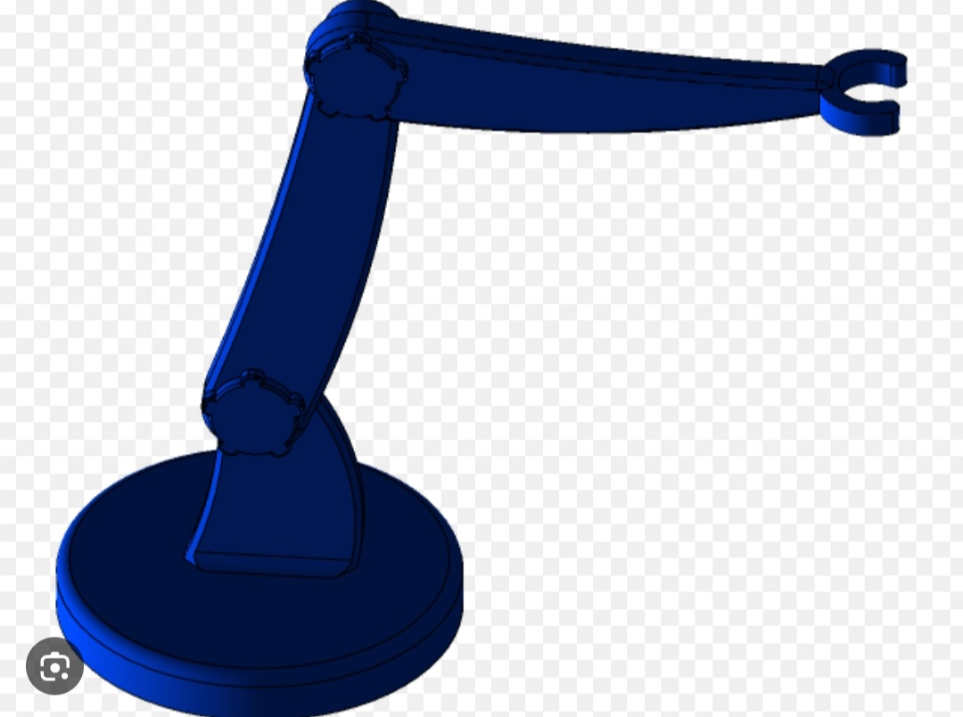
Mechanical Structure & Anatomy
Base Plate & Fixed Stand: Solid cylindrical base (Red) and orthogonal vertical pillar (Dark Gray) serving as the absolute reference anchor.
Co-axial Links: Sleek tapered Link 1 & Link 2 (Blue) configured to uniformly disperse loads and reduce rotational inertia.
Circular Tool Cup: Parallel terminal structure modeled precisely to house tools or support gripper mechanics.
ANATOMY OVERVIEW
SLIDE 3 OF 6

Slide 4
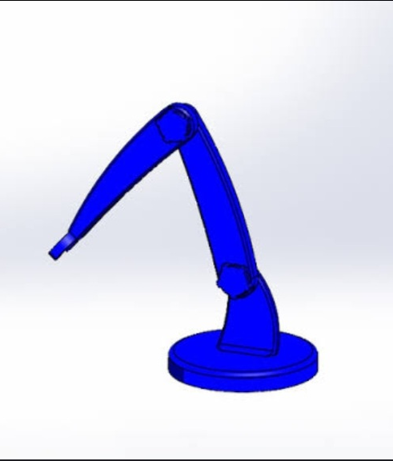
Simscape Import Protocol
Bridging CAD and Physics
The SolidWorks assembly is compiled directly into a rich XML structural script via the Simscape Multibody Link plugin.
By executing smimport(), the software automatically establishes rigid masses, spatial coordinates, 3D geometry profiles, and localized inertia parameters.
This avoids manually drawing the system and allows immediate simulation of gravitational forces and joint load torques.
CAD TO MATLAB IMPORT
SLIDE 4 OF 6

Slide 5
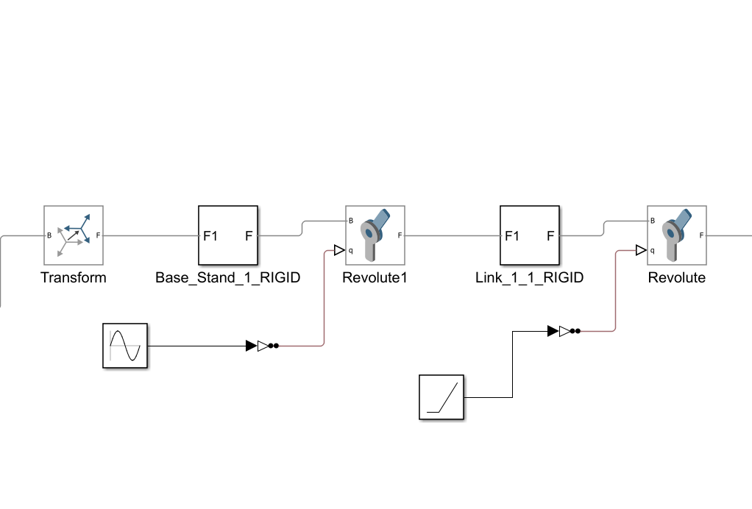
Dynamic Simulink Control Architecture
Active Actuation: Revolute Joint blocks are switched to Provided by Input to accept custom trajectory streams.
Simulink-PS Converter: Converts raw computational signals to true physics values explicitly designated as rad (radians).
Multi-Joint Trajectory: Joint 1 (Shoulder) is driven by a steady linear Ramp, while Joint 2 (Elbow) is swept via a smooth Sine Wave signal generator.
CONTROL ARCHITECTURE
SLIDE 5 OF 6

Slide 6

Conclusion
By combining clean mechanical design within SolidWorks and real-time physical simulation in MATLAB Simscape Multibody, we successfully demonstrated realistic structural constraints and smooth multi-axis trajectory control profiles.
CONCLUSION
SLIDE 6 OF 6

